Slide 1

How the Pricing Engine Works
Booking probability
Price optimization function
Revenue estimation for new listings
Expected revenue curve

Slide 2
Booking Probability Model
Random Forest model
Inputs: price, location, seasonality
Output: probability of booking
Captures non-linear demand patterns

Slide 3
Price Optimization Function
Simulates multiple price points
Predicts booking probability at each price
Computes expected revenue
Selects price that maximizes revenue

Slide 4
Revenue Prediction for New Listings
Input: new listing features
Apply trained model
Output:
optimal price + expected revenue
expected revenue curve

Slide 5
Demo

Slide 6
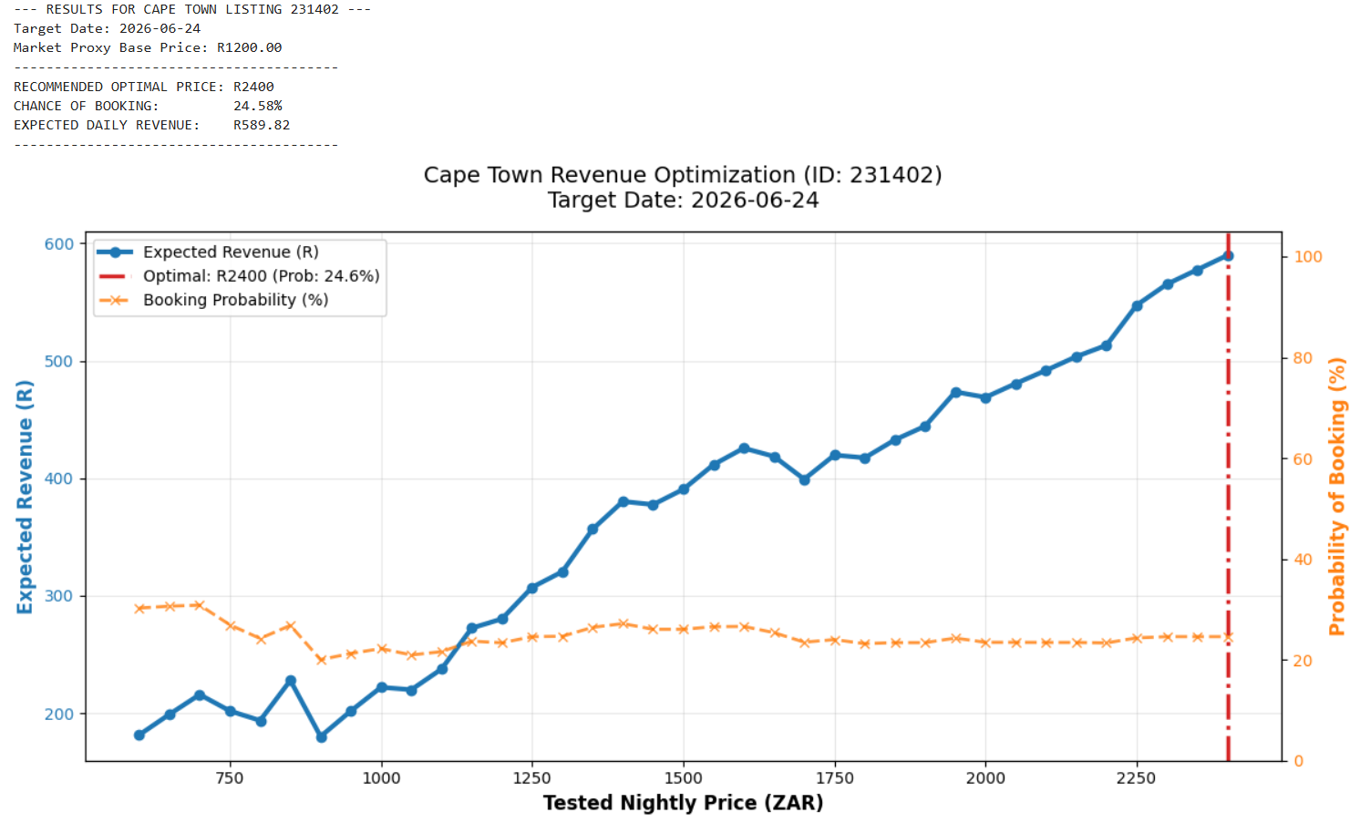
Off-peak Scenario: 2026-06-24

Slide 7
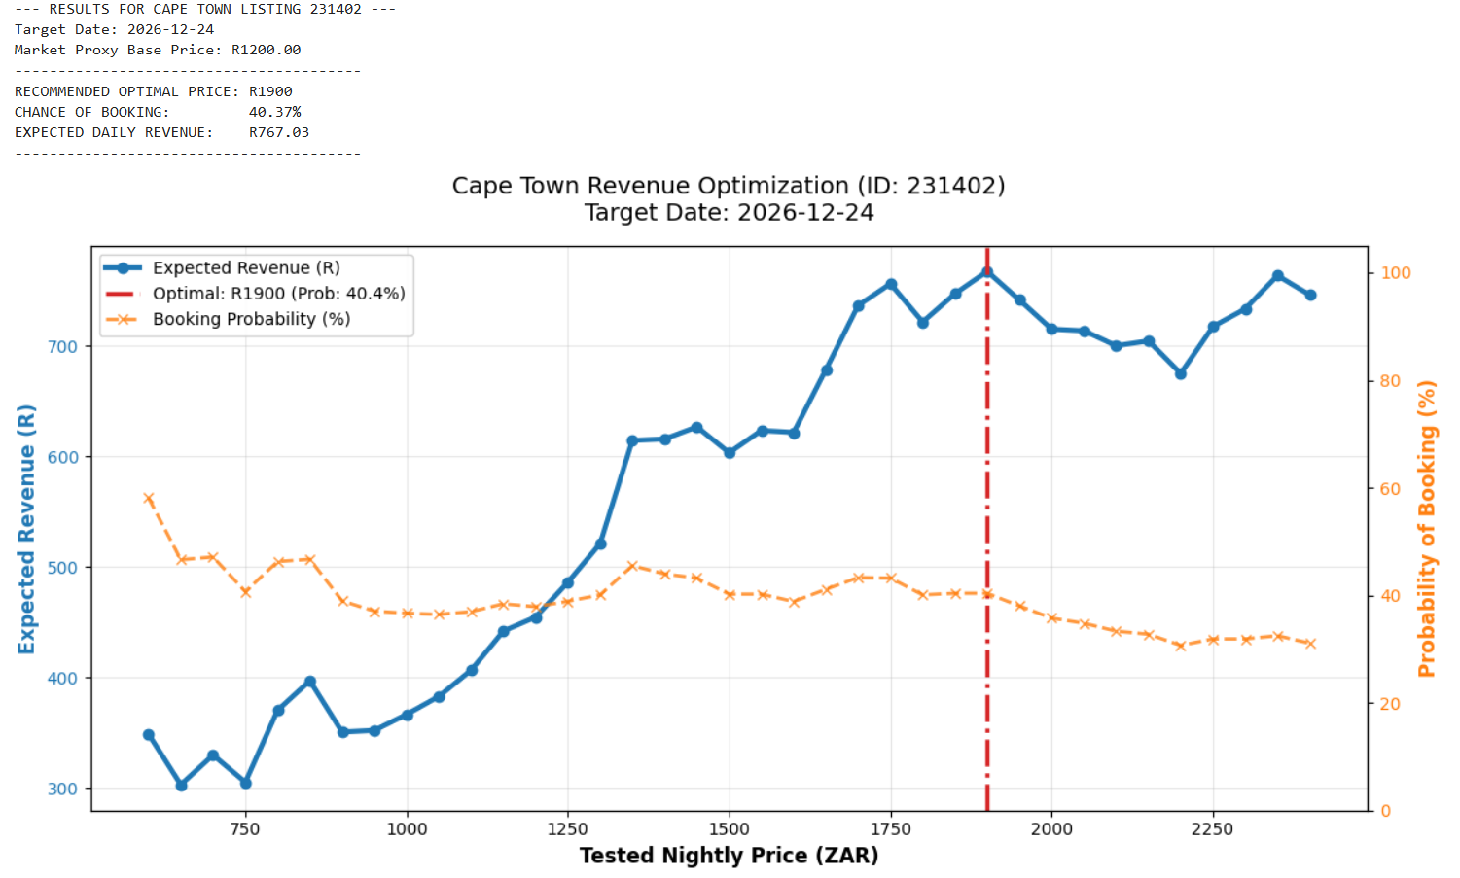
Peak Season Scenario: 2026-12-24

Slide 8

Listing 231402 Feature Analysis
Braeside House Loft Apartment
Core property profile
Property type: Entire loft
Room type: Entire home
Accommodates: 4 guests
Beds: 3
Bathrooms: 1 bath
Review score: 4.86
Neighbourhood: Ward 115
Coordinates: Cape Town City Centre / Atlantic Seaboard zone

Slide 9
Static vs dynamic pricing outcome
Static price on both dates: R1200
June dynamic: R2400 → expected revenue R589.82 vs static R294.96
December dynamic: R1900 → expected revenue R767.03 vs static R484.44
Key insight: same listing requires different strategies by date-level elasticity

Slide 10
Business Implications
Per-listing uplift: +R294.86 (June), +R282.59 (December)
Airbnb fee uplift at 3%: ~R8.85 and ~R8.48 per booking night
Scale across 10,000 similar listing-nights → >R84k incremental fee revenue
Action: deploy Smart Pricing nudges to premium, scarce, highly-rated listings

